Slide 1
Chemistry – Nov 8, 2019
Do now -
  Pick up 2 handouts
  Get out notes so we can pick up where we left off
Objective –
  Atomic History and Atomic Models (Finish)
  Atomic History WS /Atomic Theory Progress Chart Activity

Slide 2
Chemistry – Nov 8, 2019
Agenda –
  Review Early Theories
  Review Dalton’s Atomic Theory
  Review Discovery of subatomic particles
  The Nucleus
  Quantization
Assignment: -
  Atomic History Worksheet with Progress Chart Activity

Slide 3
Atomic Theory Beginnings
Democritus (c. 400 BC) (unpopular, not widely known)
  Matter is composed of atoms.
  No structure proposed. Probably considered cubic.
  Largely ignored in favor of Aristotle’s view of continuous matter for 2000 years
  Logical/Theoretical only. “Armchair science”
The Scientific Revolution (Note: Galileo trial 1633)
  The Skeptical Chemist by Robert Boyle in 1661 (discredit Aristotle)
    Established an experimental approach. Macroscopic only.
    There was no atomic model at this time.

Slide 4
Early Macroscopic Laws
Law of Conservation of Mass by Antoine Lavoisier in 1789
  Mass is conserved in chemical reactions.
  Discovered oxygen in the process.
Law of Definite Proportions
  Chemical compounds always contain exactly the same proportion of elements by mass.
  Can determine elemental percent composition of a compound.

Slide 5

John Dalton’s Atomic Theory
Based on Experimental results and early laws in 1805
Dalton’s Atomic Theory (First modern atomic model)
  Matter is composed of indivisible and indestructible atoms.
  Atoms of one element cannot be converted into atoms of another element.
  All atoms of a given element have the same mass and other properties that distinguish them from the atoms of other elements.
  Atoms combine in simple, whole-number ratios to form compounds.
Atoms are solid spheres with differing masses

Slide 6
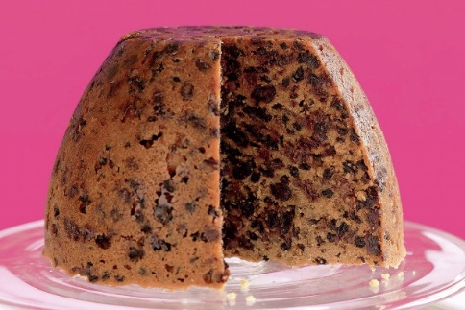
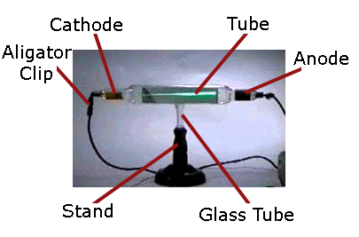
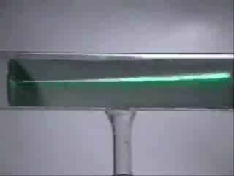
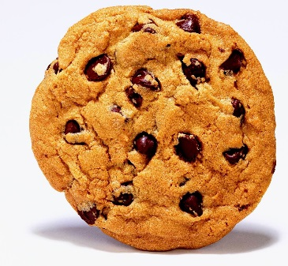
Subatomic particle discovered: the electron
  The Cathode Ray Tube was developed by Sir William Crookes.
J. J. Thomson discovered the electron with Cathode Ray tube in 1897
Measured charge to mass ratio of electron (q/m = 1.76 x 10⁸ C/g)
Data suggests the electron is 1000 times smaller than hydrogen
Proposed Plum Pudding model of atom (choc chip dough ball model)

Slide 7
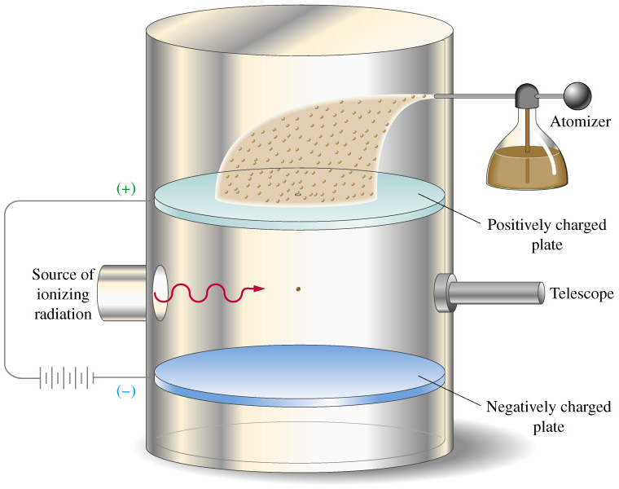
Verifying subatomic particles
Robert Millikan’s Oil-drop experiment of 1909
Accurately measured the charge of the electron q = 1.6 x 10⁻¹⁹ C
Using Thomson’s q/m ratio (q/m = 1.76 x 10⁸ C/g) found the mass of the electron too.
m = 9.1 x 10⁻³¹ kg
Atomic masses are thousands of times larger

Slide 8
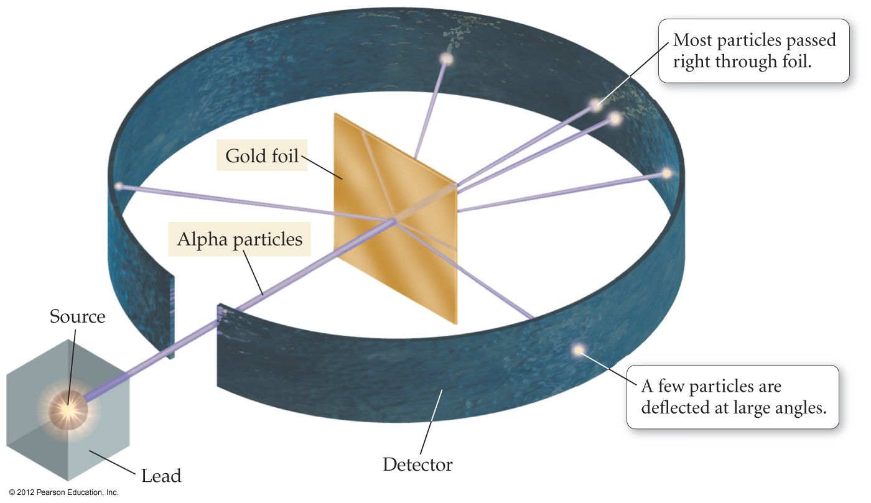
Discovery of the Nucleus
Ernest Rutherford’s Gold Foil Experiment of 1909
Concludes a small positively charged, massive nucleus.
Most of the atom is empty space

Slide 9
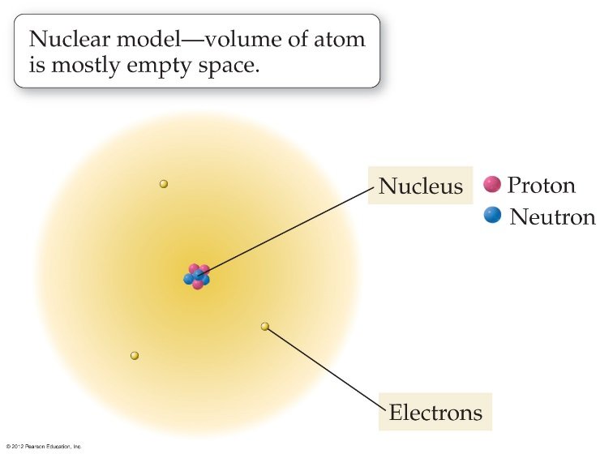
Nuclear Theory of the Atom
Most of the atom’s mass and all of it’s positive charge are contained in a small core called the nucleus.
Most of the volume of the atom is empty space through which the tiny negatively charged electrons are randomly dispersed.
There are equal numbers of positive and negative charged particles so atoms are electrically neutral.
  Equal number of protons and electrons
Neutron discovered in 1932 by James Chadwick
  Why so late?

Slide 10
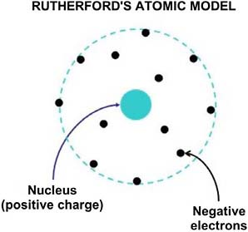
Nuclear Theory of the Atom
Most of the atom’s mass and all of it’s positive charge are contained in a small core called the nucleus.
Most of the volume of the atom is empty space through which the tiny negatively charged electrons are randomly dispersed.
There are equal numbers of positive and negative charged particles so atoms are electrically neutral.
  Equal number of protons and electrons
Neutron discovered in 1932 by James Chadwick
  Why so late?
  Nucleus contains protons and neutrons.
Physics problem

Slide 11
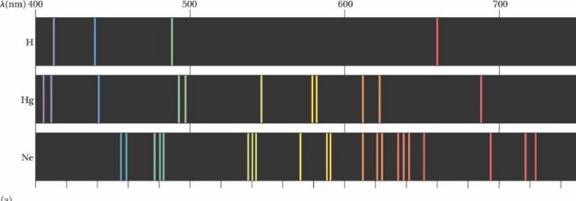
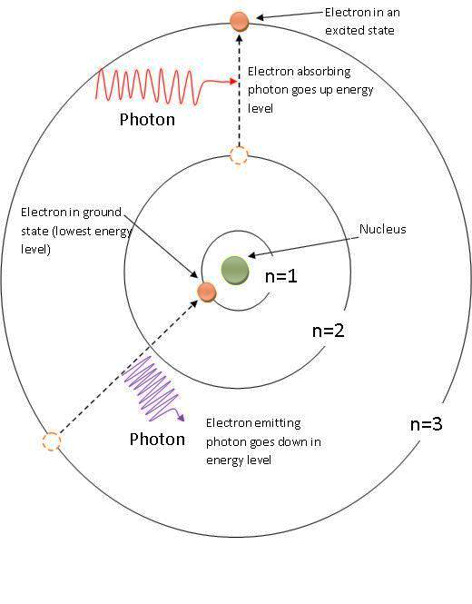
Bohr Atomic Model
Johann Balmar observed optical line spectra from electrically excited gases (neon lights) in 1885
Niels Bohr explained optical spectra of atoms in 1913
Bohr Model of the atom was first quantized model
Used fixed energy levels and restricted orbits for the electrons
Solved physics dilemma of the nuclear model

Slide 12
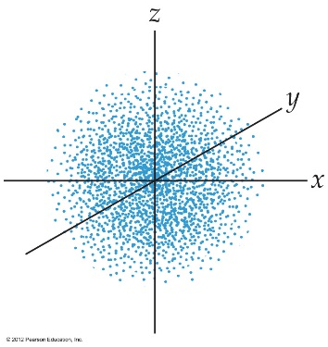
Current Atomic Theory: Quantum Mechanics
Developed by dozens of scientists in the early 20th century:
  Heisenberg, Einstein, de Broglie, Born …
  Erwin Schrödinger often given the credit
Complicated math, but exact agreement with every experimental result to date. Highly confirmed theory.
Current study of QM is done by physical chemists and physicists.
Basic atomic structure is a collection of probability electron clouds called orbitals.
We will learn more about QM later.
https://www.youtube.com/watch?v=thnDxFdkzZs Review video

Slide 13

Summary of Atomic Theory History 1
Scientists | Contribution | Atomic Model
Democritus (400 BC) | Idea of atoms | Logical discrete bits of matter (Discredited due to Aristotle)
Boyle (1661) | The Scientific Method Need to base on experiment | None.
Lavoisier (1789), | Law of Conservation of Mass | None.
Dalton (1805) | Law of Multiple Proportions Atomic Theory | Solid Spheres Atomic model

Slide 14


Summary of Atomic Theory History 2
Scientists | Contribution | Atomic Model
Thomson (1897) | Discovers Electron w/ Cathode Ray Tube | Plum Pudding/Choc Chip Pos. dough, neg. chips
Millikan (1909) | Mass & Charge of Electron with Oil-drop Experiment
Rutherford (1909); | Discovers nucleus w/ Gold Foil experiment | Positive massive nucleus, Tiny neg electrons in space Nuclear Model

Slide 15
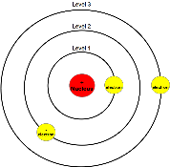
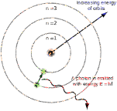
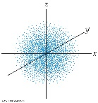
Summary of Atomic Theory History 3
Scientists | Contribution | Atomic Model
Chadwick (1932) | Discovers neutrons | Nuclear model, including neutrons
Bohr (1913) | Explains atomic spectra; Solves physics charge problem | Quantized planetary Bohr model
Schrödinger, Heisenberg, Einstein, de Broglie, Born et al. (1915-1930) | Quantum Mechanics; Wave-particle duality; Uncertainty | Quantized probability electron clouds

Slide 16
Exit Slip - Homework
Exit Slip:
Who discovered the electron?
Who discovered the nucleus?
What’s Due? (Pending assignments to complete.)
  Atomic History Worksheet
What’s Next? (How to prepare for the next day)
  Read Holt p84 - 88

